Slide 1
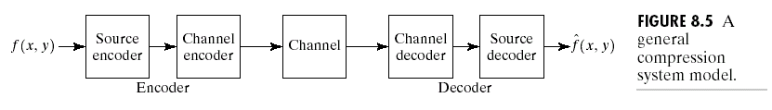

Image compression models
1

Slide 2
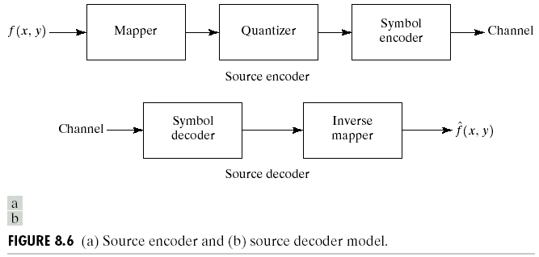
Source encoder and Decoder
2

Slide 3
Channel encoder and decoder
Source encoder contains little redundancy; hence highly sensitive to channel transmission noise
Channel encoder/decoders are designed to reduce the impact of channel noise by inserting a controlled form of redundancy into the source encoded data
Hamming codes- a useful channel encoding technique devised by Hamming
3

Slide 4
Hamming codes
Based on appending enough bits to the data being coded such that some minimum number of bits must change between valid code words
Hamming showed, if 3 bits of redundancy are added to a 4-bit word ( so that distance between any two code words is 3), all single bit errors can be detected and corrected.
By appending additional bits of redundancy, multiple bit errors can be detected and corrected
4

Slide 5
Hamming codes……
The 7-bit hamming code word( 4 bit word and 3 bit code) with a 4-bit binary number b3 b2 b1b0 is
h1 = b3 Xor b2 Xor b0
h2 = b3 Xor b1 Xor b0
h4 = b2 Xor b1 Xor b0
h3 = b3, h5 = b2, h6 = b1, h7 = b0
H1, h2, and h4 are the even parity bits for the bit fields b3 b2 b0, b3 b1 b0, and b2 b1 b0 respectively
5

Slide 6
Decoding 7-bit Hamming code word
The channel decoder must check the encoded value for odd parity over the bit fields in which even parity was previously established
A single bit error is indicated by a nonzero parity word c4 c2 c1, where
C1 = h1 Exor h3 Exor h5 Exor h7
C2 = h2 Exor h3 Exor h6 Exor h7
C4 = h4 Exor h5 Exor h6 Exor h7
If a nonzero value is found, the decoder simply complements the code word bit position indicated by the value of parity word
The decoded binary value is then extracted from the corected code word as h3 h5 h6 h7.
*
6

Slide 7
Quantization
Quantization refers to the process of approximating the continuous set of values in the image data with a finite (preferably small) set of values.
The input to a quantizer is the original data, and the output is always one among a finite number of levels.
The quantizer is a function whose set of output values are discrete, and usually finite.
*
7

Slide 8
Quantization….
Obviously, this is a process of approximation.
A good quantizer is one which represents the original signal with minimum loss or distortion.
There are two types of quantization - Scalar Quantization and Vector Quantization.
*
8

Slide 9
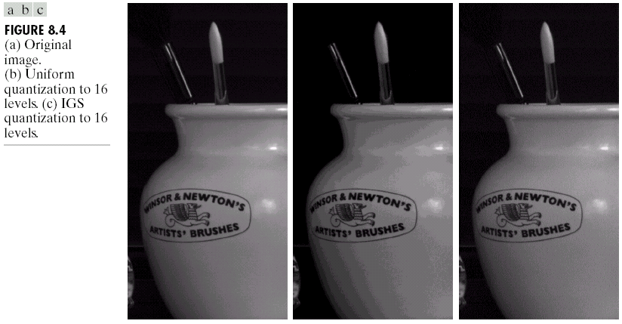
Quantization
*
9

Slide 10
Scalar and Vector quantization
In scalar quantization, each input symbol is treated separately in producing the output.
In vector quantization, the input symbols are clubbed together in groups called vectors, and processed to give the output.
This clubbing of data and treating them as a single unit increases the optimality of the vector quantizer, but at the cost of increased computational complexity.
*
10

Slide 11
Scalar Quantization
A quantizer can be specified by its input partitions and output levels (or reproduction points).
If the input range is divided into levels of equals pacing, then the quantizer is termed as a Uniform Quantizer, and if not, it is termed as a Non-Uniform Quantizer.
A uniform quantizer can be easily specified by its lower bound and the step size (r).
*
11

Slide 12
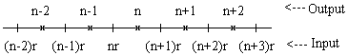
Uniform quantizer
If the input (x) falls between n*r and (n+1)*r, the quantizer outputs the symbol n.
*
12

Slide 13
Dequantizer
A Dequantizer is one which receives the output levels of a quantizer and converts them into normal data, by translating each level into a 'reproduction point' (x’)in the actual range of data.
The quantization error (x - x') is used as a measure of the optimality of the quantizer and dequantizer.
*
13

Slide 14
Optimum quantizer/ dequantizer
the optimum quantizer (encoder) and optimum dequantizer (decoder) must satisfy the following conditions.
Given the output levels or partitions of the encoder, the best decoder is one that puts the reproduction points x' on the centers of mass of the partitions. This is known as centroid condition.
Given the reproduction points of the decoder, the best encoder is one that puts the partition boundaries exactly in the middle of the reproduction points, i.e. each x is translated to its nearest reproduction point. This is known as nearest neighbour condition.
*
14

